Slide 1
Classifications
Explain the different types of occupancy classifications
Select the correct section for finding specified information in the occupancy chapters
Identify the classification of hazardous contents

Slide 2
Historic Fire
Cleveland Clinic

Slide 3
Chapter 6
Final determination by AHJ
Can be for entire building or portion of building
Specific minimum number of people or activities
Check special structures, then occupancy chapter, then general rules
Classifications (examples):
  Assembly: special amusement or 50+ gathering
    Very common
  Education: through 12th grade
  Residential: provides sleeping
  Mercantile: stores

Slide 4
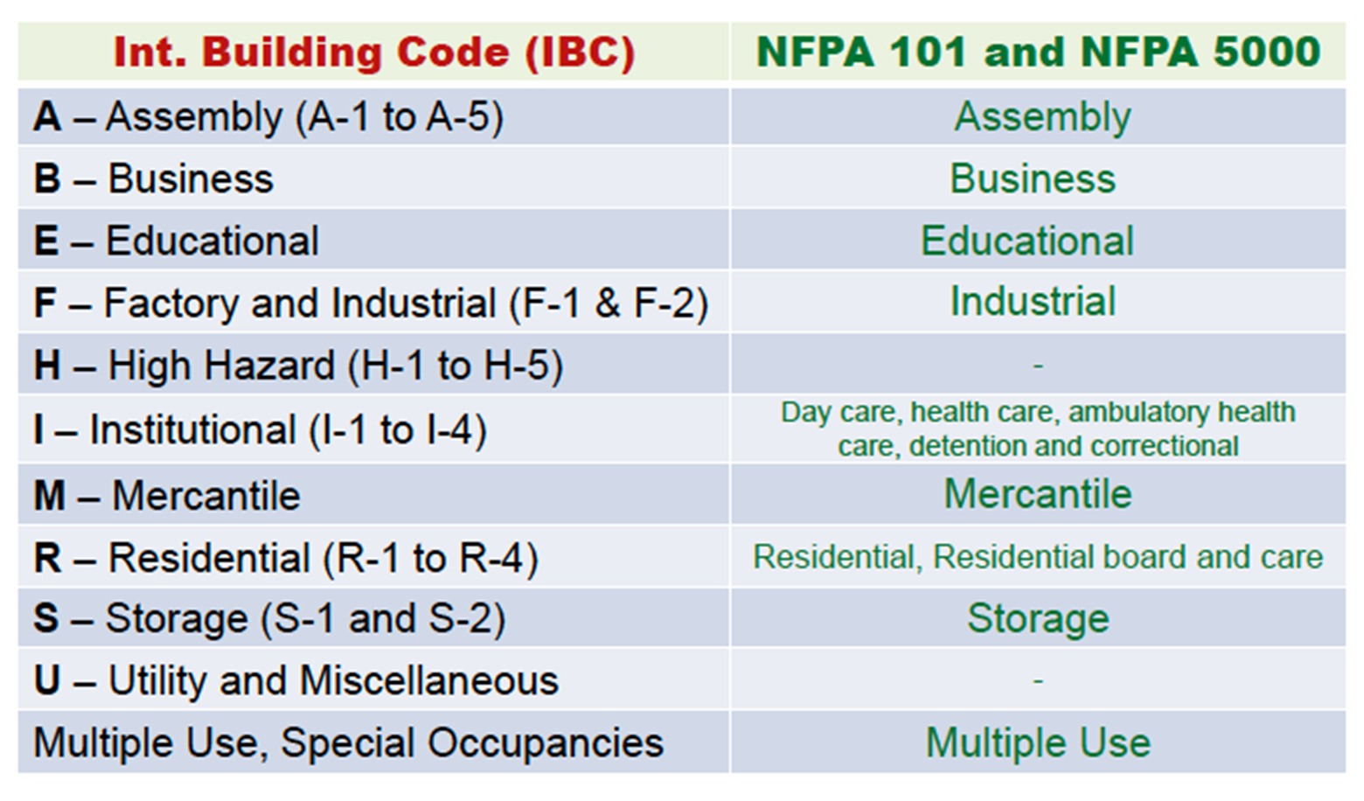
Selecting Correct Occupancy

Slide 5
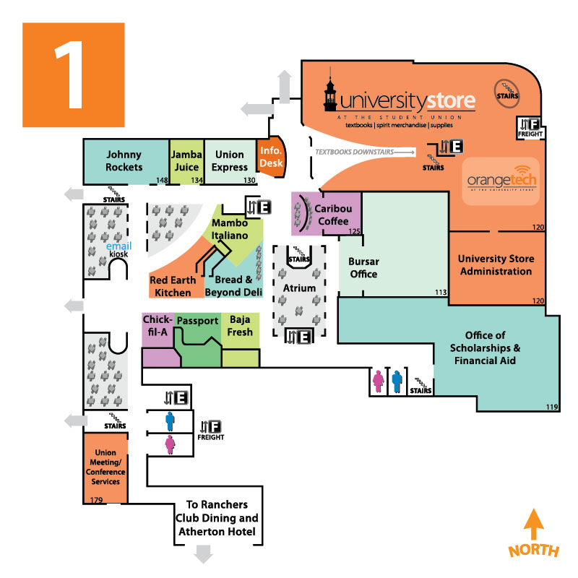
Chapter 6
Mixed
  Exit access combined
  Use most restrictive criteria
Separated
  Rated wall assembly between
  Reduced requirements with automatic sprinklers
Incidental use
  Limited
  Can use predominant

Slide 6
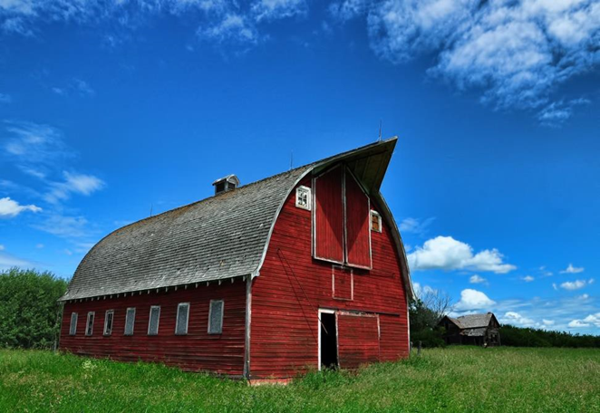
Utility Classification
Found in IBC
  Not NFPA 101
Normally unoccupied space
  Not classified elsewhere

Slide 7
Occupancy Chapter Layout
X.1 General Requirements
  Similar information to chapters 1 to 4
X.2 Means of Egress Requirements
  Similar information to chapter 7
X.3 Protection
  Similar information to chapters 8, 10, and part of 9
X.4 or X.6 Special Provisions
  Something unique to that type of building
X.5 Building Services
  Similar information to part of chapter 9
X.7 Operating Features
Reserved sections

Slide 8
Chapter 6
Hazards based on fire, smoke, and explosion threat to people
AHJ has final say
Use most restrictive in building unless separated
Classifications
  Low: No self-propagation
  Ordinary: Moderate burning, lots of smoke
  High: Rapid burning or explosion

Slide 9
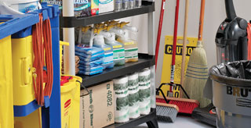
Special Hazards
Protection
  Separation
  Sprinklers
  Both
Explosion protection
Hazardous materials
Alcohol-based hand-rub dispensers
  Size limitations
  Limited locations
  Discharge limitations

